Slide 1
Socket Programming
Kajal Pawar
Emp. Id :164284

Slide 2
Why Socket Programming
“To build any Networked Application”
Ex. WWW, FTP etc.
How data is transferred across the internet between two entities , we need to understand socket programming
Ex. Telephone Network

Slide 3
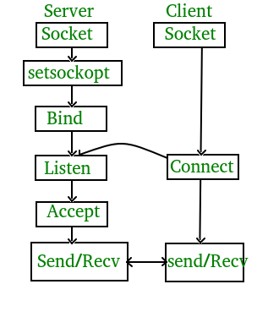
In the world of sockets…..
Server – An entity which is provider of information
Client – An Entity which is seeker for information

Slide 4
Types of Internet Sockets
Stream Sockets (SOCK_STREAM)
– Connection oriented
– Rely on TCP to provide reliable two-way connected communication
Datagram Sockets (SOCK_DGRAM)
– Rely on UDP
– Connection is unreliable

Slide 5
Stages for server and client
Socket creation:
int sockfd = socket(domain, type, protocol)
Setsockopt:
int setsockopt(int sockfd, int level, int optname, const void *optval, socklen_t optlen);
Bind:
int bind(int sockfd, const struct sockaddr *addr, socklen_t addrlen);

Slide 6
Listen:
int listen(int sockfd, int backlog);
Accept:
int new_socket= accept(int sockfd, struct sockaddr *addr, socklen_t *addrlen);
Connect:
int connect(int sockfd, const struct sockaddr *addr, socklen_t addrlen);

